Slide 1
SUMY STATE UNIVERSITY
BALATSKY ACADEMIC AND SCIENTIFIC INSTITUTE
OF FINANCE, ECONOMICS AND MANAGEMENT
Theme 2: The EU trade policy
“EU trade opportunities and challenges for Ukraine” (573581-EPP-1-2016-1-UAEPPJMO-MODULE).
Compiled by the Student:
Iryna Oliinyk
Economics, Entrepreneurship and Business Administration
Sumy State University
UKRAINE

Slide 2
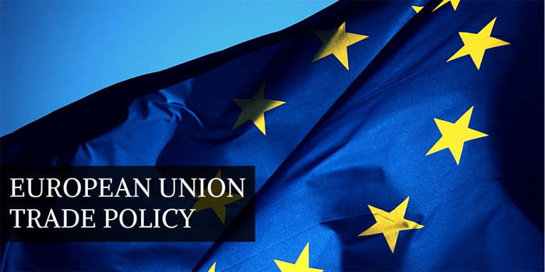

Slide 3
The European trade policy system
1.Nontariff barriers and tariff barriers
2.Free trade regime
3.Industrial policy
4.Economic partnership agreements
5.Trade policy and enlargement
6.EU foreign policy,
7.Competitiveness and support for business

Slide 4
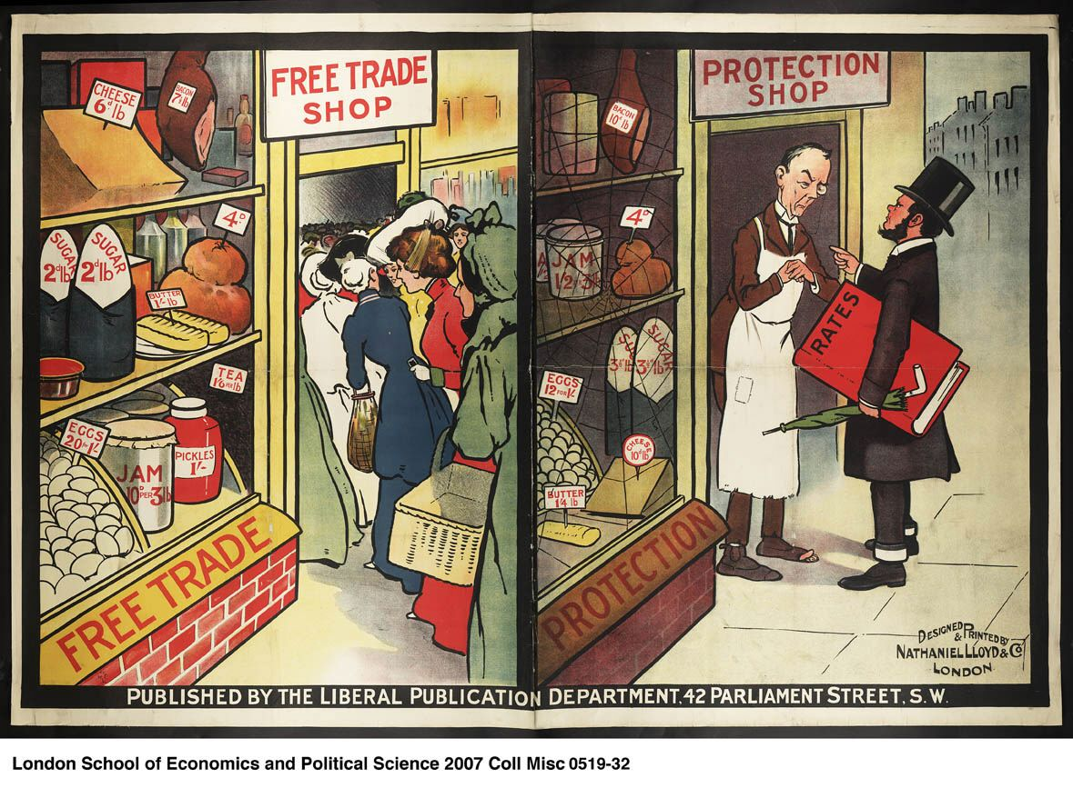
1. Nontariff barriers and tariff barriers
Non- tariff barriers
Non-Tariff Barriers (NTBs) include all the rules, regulations and bureaucratic delays that help in keeping foreign goods out of the domestic markets.
Tariff Barriers
Tariff is a tax levied on goods traded internationally, that is on imports. As a result, the price level of imported products rises and the demand for them decrease, thus imports are less.

Slide 5
TYPES OF NON-TARIFF BARRIERS
Non- Tariff Barriers to trade can be categorized in six types:
Specific Limitations on Trade:
Quota shares
A quota is a restriction in value or in physical terms, imposed on import and export of certain goods for a certain period of time
Import licenses/ Restrictive licenses
Import licensing can be defined as administrative procedures requiring the submission of an application or other documentation, other than those required for customs purposes, to the relevant administrative body as a prior condition for importation of goods .

Slide 6
Exchange controls
This is monitoring the amount of foreign exchange available to residents for purchasing foreign goods domestically or while travelling abroad is another way of restricting imports.
Import bans/ limitations
This is a government order forbidding imports of a specific kind or from a particular country.
Embargoes
Embargo is a particular type of quotas prohibiting the trade, in other words, when imports from a specific country are totally banned. It is mostly put in place due to political reasons

Slide 7
Customs and Administrative Entry Procedures
Customs Valuation
If the value ascribed to a particular product would turn out to be considerably higher than its real cost, it could end in affecting its competitiveness by increasing the total cost to the importer due to the excess duty. This would hence act as a barrier to international trade.
Antidumping practice
If a company exports a product at a price lower than the price it normally charges on its own home market, it is said to be "dumping" the product. Antidumping is prohibiting a country to dump, that is, to export goods at usual lower prices.

Slide 8
Documentation requirements
This is when complicated and unnecessary documentation requirements are asked by the importing countries
Rules of origin
Determining where a product comes from is no longer easy when raw materials and parts across the globe are used as inputs in the manufacturing plants. Rules of origin are important in implementing such trade policy instruments as anti-dumping and countervailing duties, origin marking, and safeguard measures.

Slide 9
Technical barriers to trade
Technical Barriers
Countries generally specify some quality standards to be met by imported goods for various health, welfare and safety reasons This facility can be misused for blocking the import of certain goods from specific countries by setting up of such standards, which deliberately exclude these products.
The Precautionary Principle
The precautionary principle, is a government restrictions on trade in the context of environmental and health concerns, often regardless of cost or scientific evidence.

Slide 10
Sanitary and phytol-sanitary conditions
This is a restriction on imports from certain places in order to protect consumers, the environment, or agriculture from harmful diseases or pests that may accompany the imported product.
Packaging conditions, labeling conditions and product standards.
Countries usually impose standards on classification, labeling and testing of products in order to be able to sell domestic products, but also to block sales of products of foreign manufacture. These standards are occasionally entered under the excuse of protecting the safety and health of local populations.

Slide 11
Government Participation in Trade
Complex regulatory environment
Some countries have complex regulatory framework, for e.g. complex business registration and license, and thus this hamper free trade.
Government procurement policies
This is another type of NTB where governments pretty frequently follow the policy of procuring their requirements (including that of government-owned companies) only from local producers, or at least extend some price advantage to them. This closes a big potential market to the foreign producers.

Slide 12
Subsidies to Local Goods
This occurs when governments directly or indirectly subsidize local production in an effort to make it more competitive in the domestic and foreign markets.
Countervailing duties
This is a duty placed on imported goods that are being subsidized by the importing government. This helps to even the playing field between the domestic producers and the foreign producers receiving subsidies.
"Buy national" policy
This is a policy hosted by the government to help the national economy.

Slide 13
Border taxes
It is a tax system for imports and exports, especially one that compensates for internal taxes in Common Market countries by levying fees or paying rebates
Voluntary Export Restraints
This is an act of limiting exports. It happens when a country facing a persistent huge trade deficit against another country pressurized the latter to adhere to a self-imposed limit on the exports. For instance, after facing consistent trade deficits over a number of years with Japan, the US persuaded it to impose such limits on itself.

Slide 14
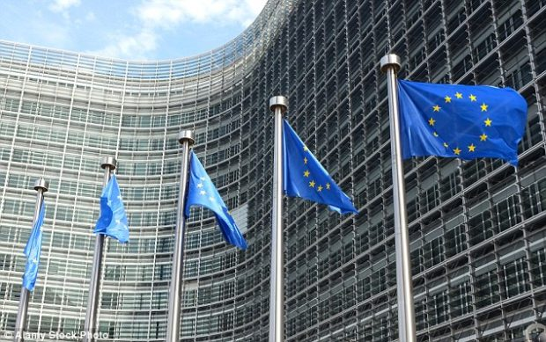
Direct and Indirect Restrictions on Foreign Investments
A country may directly restrict foreign investment to some specific sectors or up to a certain percentage of equity. Indirect restrictions may come in the form of limits on profits that can be repatriated or prohibition of payment of royalty to a foreign parent company. These restrictions discourage foreign producers from setting up domestic operations.

Slide 15
2. Free trade regime
Legal basis
Following the 2002 Communication on ‘Trade and Development: Assisting Developing Countries to Benefit from Trade and the 2010 Communication on ‘Trade, Growth and World Affairs: Trade Policy as a core component of the EU’s 2020 Strategy, the 2012 Communication on ‘Trade, growth and development: Tailoring trade and investment policy for those countries most in need clearly reflects a change in the ‘trade and development’ paradigm

Slide 16
Objectives of EU preferential market access schemes
The GSP scheme, which was introduced in 1971, has three principal elements.
One is the standard Generalized System of Preferences (GSP), an autonomous trade arrangement through which the EU offers certain foreign goods non-reciprocal preferential access to the EU market in the form of reduced or zero tariffs.
The second element (GSP+) is a specific incentive arrangement offering tariff reductions to vulnerable countries that have ratified and implemented international conventions relating to human and labor rights, the environment and good governance.
The third component is the Everything But Arms (EBA) initiative which guarantees duty-free and quota-free access to the EU for all products except arms and ammunition for 49 least-developed countries (LDCs).

Slide 17
A narrowed income conditionality has been added to the ‘standard’ GSP, reducing duties on approximately 66% of all tariff lines, to ensure that vulnerable developing countries with low and lower-middle incomes become the main target group.
Economic Partnership Agreements
The trade agreements called Economic Partnership Agreements (EPAs) became the principal instruments for promoting trade between the EU and the African, Caribbean and Pacific regions under the Cottoned Agreement of 2000.

Slide 18
3. Industrial policy
EU industrial policy
The 2014 Communication, For a European Industrial Renaissance sets out the Commission’s priorities for industrial policy and calls on EU countries to recognize the central importance of industry for creating growth and jobs. It provides an overview of actions undertaken and puts forward new ones to:
mainstream industrial competitiveness in other policy areas
maximize the potential of the Single Market, notably through standards and market surveillance
use the instruments for regional development to support innovation, skills and entrepreneurship
develop the skills that industries need and facilitate labor mobility
promote access to critical inputs (energy and raw materials) to encourage industrial investment
facilitate the integration of EU firms in global value chains

Slide 19
What the Commission does?
They are committed to helping European industries be competitive and generate growth and jobs. They develop policies and actions for the modernizations of the industrial base and for the transition towards an ever more innovative, modern and sustainable economy.

Slide 20
4. Economic partnership agreements
Economic Partnership Agreements in a nutshell
Economic Partnership Agreements:
are a process dating back to the signing of the Cotonou Agreement.
are "tailor-made" to suit specific regional circumstances.
are WTO-compatible agreements, but go beyond conventional free-trade agreements, focusing on ACP development, taking account of their socio-economic circumstances and including co-operation and assistance to help ACP countries benefit from the agreements.
open up EU markets fully and immediately, but allow ACP countries long transition periods to open up partially to EU imports while providing protection for sensitive sectors.
provide scope for wide-ranging trade co-operation on areas such as sanitary norms and other standards.
create joint institutions that monitor the implementation of the agreements and address trade issues in a cooperative way.
last but certainly not least, are also designed to be drivers of change that will help kick-start reform and contribute to good economic governance. This will help ACP partners attract investment and boost their economic growth.
Read the EPA factsheet and the EPA brochure, and see what the benefits of EPAs are.

Slide 21
5. Trade policy and enlargement
EU trade policy is working to:
1. Create a global system for fair and open trade
The World Trade Organization has helped shape a system of global trade rules that keeps the global economy open for trade as well as reflects and respect the needs and concerns of developing countries.
2. Open up markets with key partner countries
We seek to create growth and jobs for Europeans by increasing their opportunities to trade with the world. One way of opening markets is to negotiate better access and conditions for trade and investment through free trade agreements.

Slide 22
3. Make sure everyone plays by the rules
EU trade policy aims to open new markets for European exporters, workers and investors through lifting barriers to the markets of our trading partners. We work closely with countries outside Europe to:
remove persistent problems for exporters
increase the opportunities for EU businesses to get equal access to procurement markets outside the EU
reduce counterfeiting and piracy of European goods
open up new opportunities for European investment

Slide 23
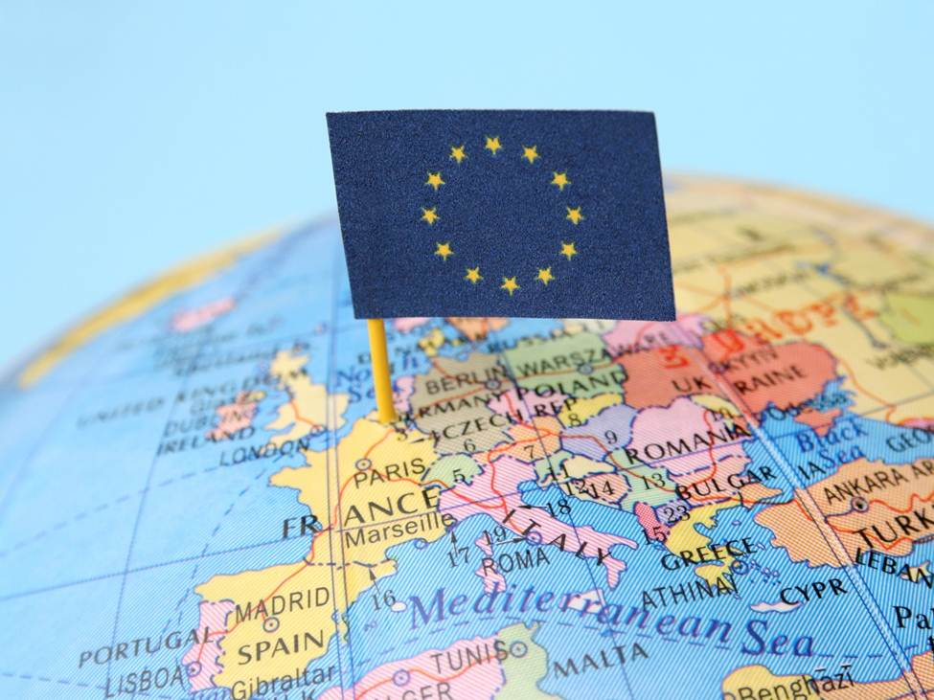
4. Ensure trade is a force for sustainable development
We are committed to actively helping people around the world trade their way out of poverty. Europe has opened its markets to all imports from the world's poorest countries, and works actively to help developing countries build the capacity to take advantage of trade.

Slide 24
Trade policy and enlargement
“Trade for all – towards a more responsible trade and investment policy”. The EU aims to play a key role in keeping markets open worldwide and helping Europe to exit from the economic crisis

Slide 25
6. EU foreign policy
The Common Foreign and Security Policy (CFSP) is the organised, agreed foreign policy of the European Union (EU) for mainly security and defence diplomacy and actions
The objectives of foreign policy:
- to guarantee the protection of values, basic interests, security, independence, integrity,
- to preserve peace, prevent conflicts,
- Strengthen and support human rights,
- to provide assistance to the population and regions affected by disasters.

Slide 26
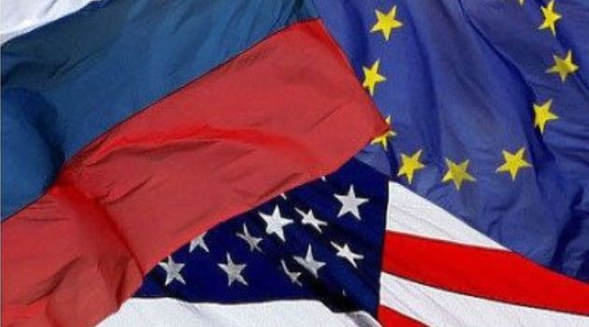
Bodies
There are a number of bodies set up within the context of the CFSP.
Two bodies carried over from the Western European Union are:
European Union Institute for Security Studies (EUISS)
European Union Satellite Centre (EUSC).

Slide 27
7. Competitiveness and support for business
World Bank Group Experts Help Countries Compete In Global Markets
The World Bank Group has developed a range of tools for policy-makers to better understand and exploit a wide range of factors that impact competitiveness, including:
countries' export composition,
export sophistication level,
export diversification.

Slide 28
References
1. European Commission [Electronic resource]. – Mode of access : http://ec.europa.eu/trade/policy/
2. Trade regimes applicable to developing countries [Electronic resource]. – Mode of access : http://www.europarl.europa.eu/atyourservice/en/displayFtu.html?ftuId=FTU_6.2.3.html
3. Industrial policy [Electronic resource]. – Mode of access : http://ec.europa.eu/growth/industry/policy/
4. EU position in world trade [Electronic resource]. – Mode of access : http://ec.europa.eu/trade/policy/eu-position-in-world-trade/
5. Enlargement of the European Union [Electronic resource]. – Mode of access : https://en.wikipedia.org/wiki/Enlargement_of_the_European_Union
6. Economic partnerships - Trade [Electronic resource]. – Mode of access : http://ec.europa.eu/trade/policy/countries-and-regions/development/economic-partnerships/
7. Common Foreign and Security Policy [Electronic resource]. – Mode of access : https://en.wikipedia.org/wiki/Common_Foreign_and_Security_Policy
8. Trade Competitiveness [Electronic resource]. – Mode of access : http://www.worldbank.org/en/topic/trade/brief/trade-competitiveness
9. Accessing markets - Trade [Electronic resource]. – Mode of access : http://ec.europa.eu/trade/policy/accessing-markets/
10. European Union Trade Policy [Electronic resource]. – Mode of access : http://www.powershow.com/view/1371cc-YThhN/European_Union_Trade_Policy_powerpoint_ppt_presentation

Slide 29
Thank you for attention

