Slide 1


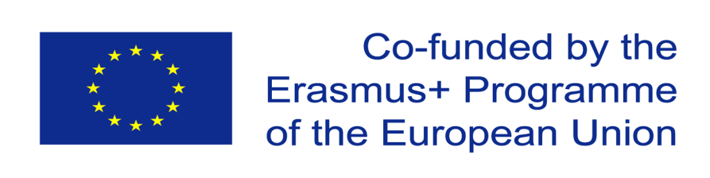
SUMY STATE UNIVERSITY
BALATSKY ACADEMIC AND SCIENTIFIC INSTITUTE
OF FINANCE, ECONOMICS AND MANAGEMENT
Theme 3: EU-Ukraine Trade Cooperation
“EU trade opportunities and challenges for Ukraine” (573581-EPP-1-2016-1-UAEPPJMO-MODULE).
Compiled by the Student:
Alyona Sergienko
Economics, Entrepreneurship and Business Administration
Sumy State University
UKRAINE

Slide 2
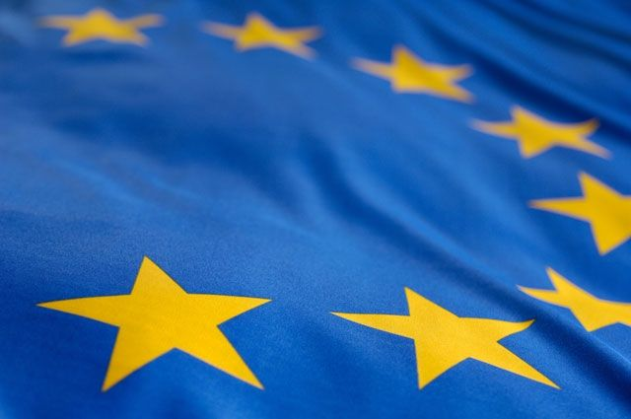
EU-Ukraine trade cooperation
European Neighbourhood Policy
Partnership and Cooperation Agreement
Principles of GATT/WTO
Deep and Comprehensive Free Trade Area (DCFTA)
Association Agreement

Slide 3
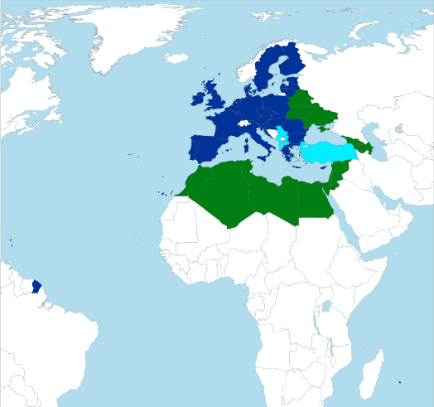
1. European Neighbourhood Policy
European Neighborhood Policy; The ENP (formerly the European Neighborhood and Partnership Instrument - ENPI) is a new approach of the European Union to neighboring countries with the aim of strengthening relations between the European Union and its neighboring countries and cooperation to create a security and welfare zone, a "ring of friendly countries" on the borders of the European Union.

Slide 4




The ENP is also called upon to give the EU neighbors the opportunity for closer cooperation with the EU in the fields of politics, security, economy and culture.

Slide 5
financial support – grants worth €12 bn were given to ENP-related projects from 2007 to 2013
economic integration and access to EU markets – in 2011 trade between the EU and its ENP partners totalled €230bn
easier travel to the EU – 3.2 m Schengen visas were issued to citizens, and in particular to students from ENP countries in 2012
technical and policy support

Slide 6
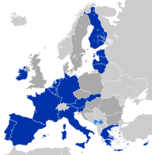
ENP countries
Of the 16 ENP countries:
12 are currently are already fully participating as partners in the ENP, having agreed on ENP action plans:
Armenia
Azerbaijan
Egypt
Georgia
Israel
Jordan
Lebanon
Moldova
Morocco
Palestine*
Tunisia
Ukraine
Algeria is currently negotiating an ENP action plan
Belarus, Libya and Syria remain outside most of the structures of ENP.

Slide 7
Multilateral partnerships
The ENP is chiefly a bilateral policy between the EU and each partner country. But it is complemented by regional and multilateral cooperation initiatives:
Eastern Partnership
the Union for the Mediterranean Partnership
Black Sea Synergy

Slide 8
How does it work?
The ENP review proposes revised joint priorities for cooperation, better suited to the challenges of our time and adapted to the regions evolutions. In addition to good governance, democracy, rule of law and human rights, three other sets of joint priorities have been identified, each of them covering a wide number of cooperation sectors:
1) economic development for stabilisation;
2) the security dimension and
3) migration and mobility.

Slide 9
Taxation
European Neighbourhood Policy promotes good governance and the modernisation of tax systems in order to combat cross-border tax fraud and tax evasion without hindering trade, investment and fair competition.
For example, tax cooperation aiming to decrease the high excise duty differences on tobacco products (cigarettes etc.) between the EU and its partners, helps to reducecrimes such as smuggling across common borders, increases budget revenues and contributes to a higher level of health protection.

Slide 10
2. Partnership and Cooperation Agreement
The conclusion of the PCA allowed to establish a regular bilateral dialogue between Ukraine and the EU on political and sectoral levels, to introduce trade regulations based on the principles of GATT/WTO, to determine the priorities of Ukrainian legislation adaptation to the European norms and standards (acquis communautaire) in main sectors of the Ukrainian economy. 7 priorities were listed in the PCA, such as: energy, trade and investments, justice and home affairs, adaptation of Ukrainian legislation to that of the EU, environment protection, transport, border cooperation, cooperation in areas of science, technology and space.

Slide 11
  3. Principles of GATT/WTO
The World Trade Organization (WTO) is an intergovernmental organization which regulates international trade. The WTO officially commenced on 1 January 1995 under the Marrakesh Agreement, signed by 123 nations on 15 April 1994, replacing the General Agreement on Tariffs and Trade (GATT), which commenced in 1948.

Slide 12
Functions
Among the various functions of the WTO, these are regarded by analysts as the most important:
It oversees the implementation, administration and operation of the covered agreements.
It provides a forum for negotiations and for settling disputes.

Slide 13
The WTO shall facilitate the implementation, administration and operation and further the objectives of this Agreement and of the Multilateral Trade Agreements, and shall also provide the frame work for the implementation, administration and operation of the multilateral Trade Agreements.
The WTO shall provide the forum for negotiations among its members concerning their multilateral trade relations in matters dealt with under the Agreement in the Annexes to this Agreement.
The WTO shall administer the Understanding on Rules and Procedures Governing the Settlement of Disputes.
The WTO shall administer Trade Policy Review Mechanism.
With a view to achieving greater coherence in global economic policy making, the WTO shall cooperate, as appropriate, with the international Monetary Fund (IMF) and with the International Bank for Reconstruction and Development (IBRD) and its affiliated agencies.

Slide 14
Principles of the trading system
Non-discrimination.
Reciprocity.
Binding and enforceable commitments.
Transparency.
Safety values.

Slide 15
  4. Deep and Comprehensive Free Trade Area (DCFTA)
The Deep and Comprehensive Free Trade Areas (DCFTA) are three free trade areas established between the European Union, and Georgia, Moldova and Ukraine respectively. The DCFTAs are part of each country's EU Association Agreement. They allow Georgia, Moldova and Ukraine access to the EU's internal market in selected sectors and grant EU investors in those sectors the same regulatory environment in the associated country as in the EU.

Slide 16
Trade picture
The EU is Ukraine's largest trading partner, accounting for more than 40% of its trade in 2015. Ukraine accounts for 0.8% of EU's total trade, with a turnover of €1.16 bn in 2015.
Ukraine exports to the EU amounted to €12.7 bn in 2015. The main Ukraine exports are raw materials (iron, steel, mining products, agricultural products), chemical products and machinery.
The EU exports to Ukraine amounted to over €13.9 bn in 2015. The main EU exports to Ukraine include machinery and transport equipment, chemicals, and manufactured goods.
The EU is a large investor in Ukraine. EU investors held investments worth around €16.4 bn in Ukraine in 2014.

Slide 17
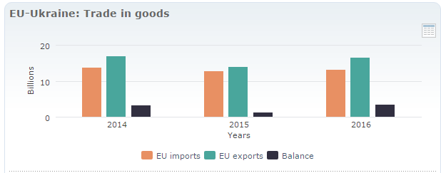
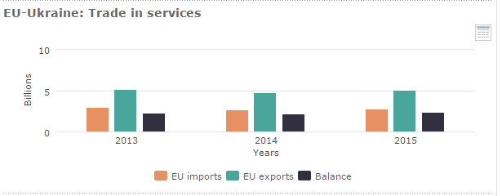

Slide 18
5. Association Agreement
On 27 June 2014, the EU-Ukraine Association Agreement was signed by European Union Heads of State and Government and Ukrainian President Petro Poroshenko in Brussels.
The Association Agreement was simultaneously ratified by the Verkhovna Rada and the European Parliament on 16 September 2014.

Slide 19
What is in the Association Agreement?
The Association Agreement is a pioneering document: it is the first agreement based on political association between the EU and any of the Eastern Partnership countries, and is unprecedented in its breadth (number of areas covered) and depth (detail of commitments and timelines).

Slide 20
It includes a Deep and Comprehensive Free Trade Area – this will go further than classic free trade areas, as it will both open up markets but also address competitiveness issues and the steps needed to meet EU standards and trade on EU markets.

